Slide 1
Boosting Algorithm - Regression
Ada Boost
XG Boosting
LG Boosting

Slide 2
ADABOOST - Sequential Learning
An AdaBoost regressor is a meta-estimator that begins by fitting a regressor on the original dataset and then fits additional copies of the regressor on the same dataset but where the weights of instances are adjusted according to the error of the current prediction.

Slide 3
Purpose of AdaBoost
improve binary classification performance
improves prediction accuracy by combining multiple "weak" classifiers into a strong classifier
focusing on misclassified data points in each iteration

Slide 4
Applications of AdaBoost
face detection
object recognition
text classification
AdaBoost can also be used in other areas of machine learning, such as regression and clustering

Slide 5
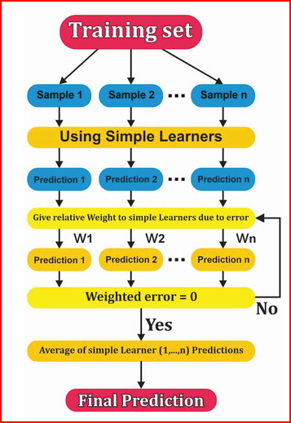
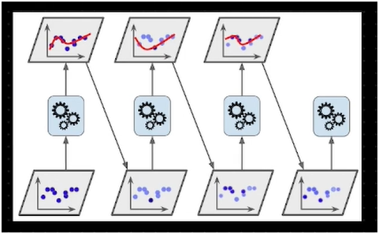
Misclassified data points transfer into another model
Final model – strong learner (Combination of various week learners)

